Slide 1
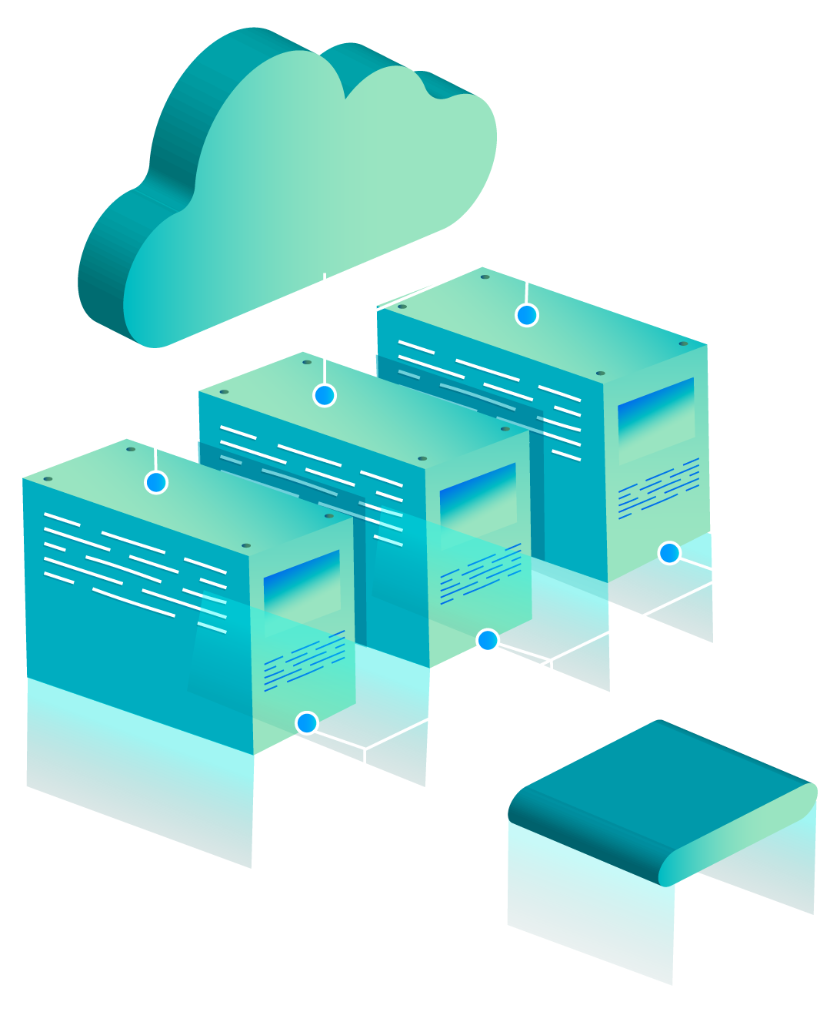
End-to-End DevOps, Cloud & AIOps Project

Slide 2

Project Team & Vision
Led by a dedicated team of experts, this initiative pushes the boundaries of cloud engineering and operational intelligence. Our collective vision was to build a resilient, automated, and intelligent system from the ground up.
Mahmoud Mohamed: Docker/CI/CD/Monitoring Specialist
Eslam Fouad: CI/CD/Monitoring Specialist
Ezzat Tarek: EKS Cluster Architect
Omar Tamer: Infrastructure Engineer
Rawan Mohamed: AIOps & Anomaly Detection Expert

Slide 3
TABLE OF CONTENTS
Full-Stack Application (Node.js + Frontend)
AIOps–Metrics-BasedAnomalyDetection
01
04
CI/CDPipeline(GitHubActions)
02
03
KubernetesMonitoringLayer
TerraformInfrastructure(Multi-CellEKSArchitecture
05
05
DeploymentProcess
05
06

Slide 4

01
Full-Stack Application (Node.js + Frontend)

Slide 5

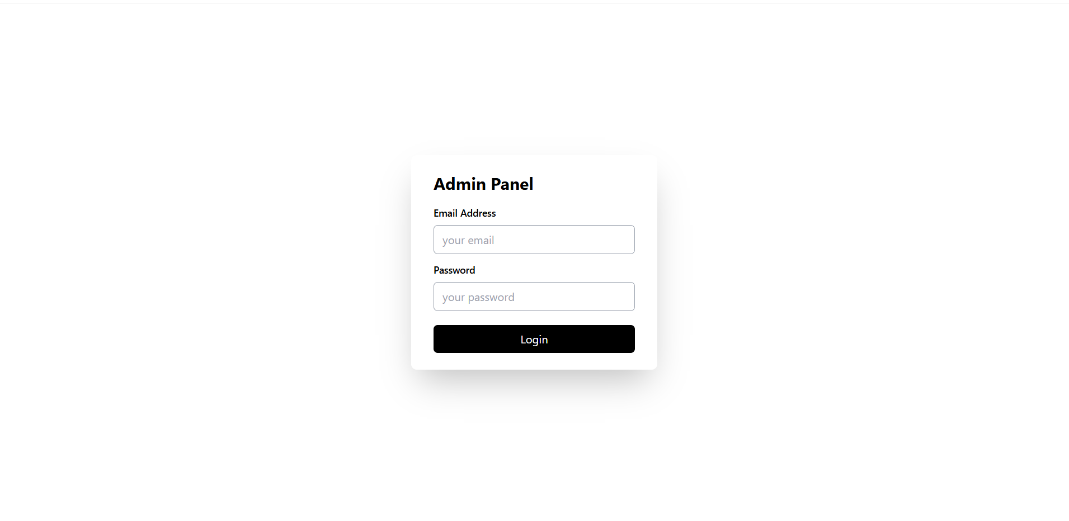
Full-Stack Application Architecture
Our application is a unified, production-ready Node.js backend and frontend, designed for optimal performance and scalability in cloud environments.
Unified Stack
Serves API + frontend from a single, cohesive container for streamlined deployment and management.
Optimized Image
Multi-stage Docker build ensures a minimal, secure, and production-ready image.
Cloud-Native Ready
Engineered for horizontal scaling on Kubernetes/ECS, leveraging cloud elasticity.

Slide 6







Efficient Docker Build Stages
Our Docker strategy employs multi-stage builds to create lean and secure images, optimizing for both development speed and production robustness.
Frontend Build
Backend Build
Runtime Image
Optimizes static assets, transpiles code, and prepares the user interface for deployment.
Installs all necessary production dependencies, ensuring a stable and functional API layer.
Based on node:20-slim, includes only production dependencies, and exposes port 5000 for service access.

Slide 7
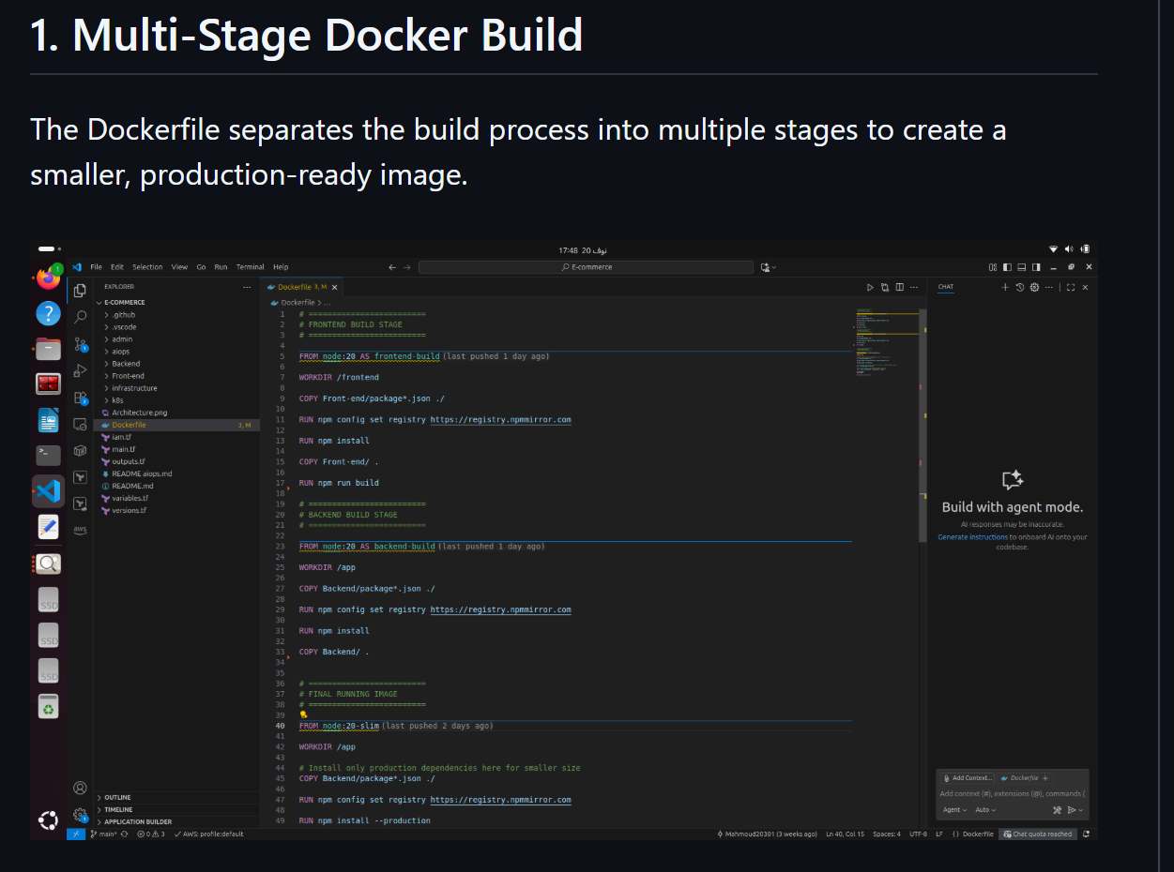

Slide 8
02
Automated CI/CD Pipeline (GitHub Actions)

Slide 9
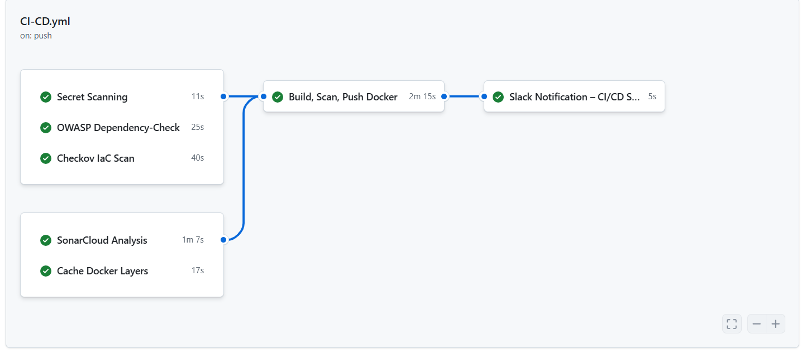
Automated CI/CD Pipeline (GitHub Actions)
Our GitHub Actions pipeline automates the entire software delivery lifecycle, from code commit to deployment, ensuring speed, reliability, and consistent quality.
Code Analysis
SonarCloud integration performs static analysis for code quality, security vulnerabilities, and test coverage, ensuring high standards.
Docker Caching
Leverages Docker layer caching to significantly accelerate build times, improving developer productivity and iteration speed.
Build, Scan & Push
Builds Docker images, runs Trivy for vulnerability scanning, and pushes secure images to Docker Hub & AWS ECR.
Notifications
Configures Slack alerts for real-time updates on pipeline success or failure, ensuring immediate awareness and quick response.

Slide 10
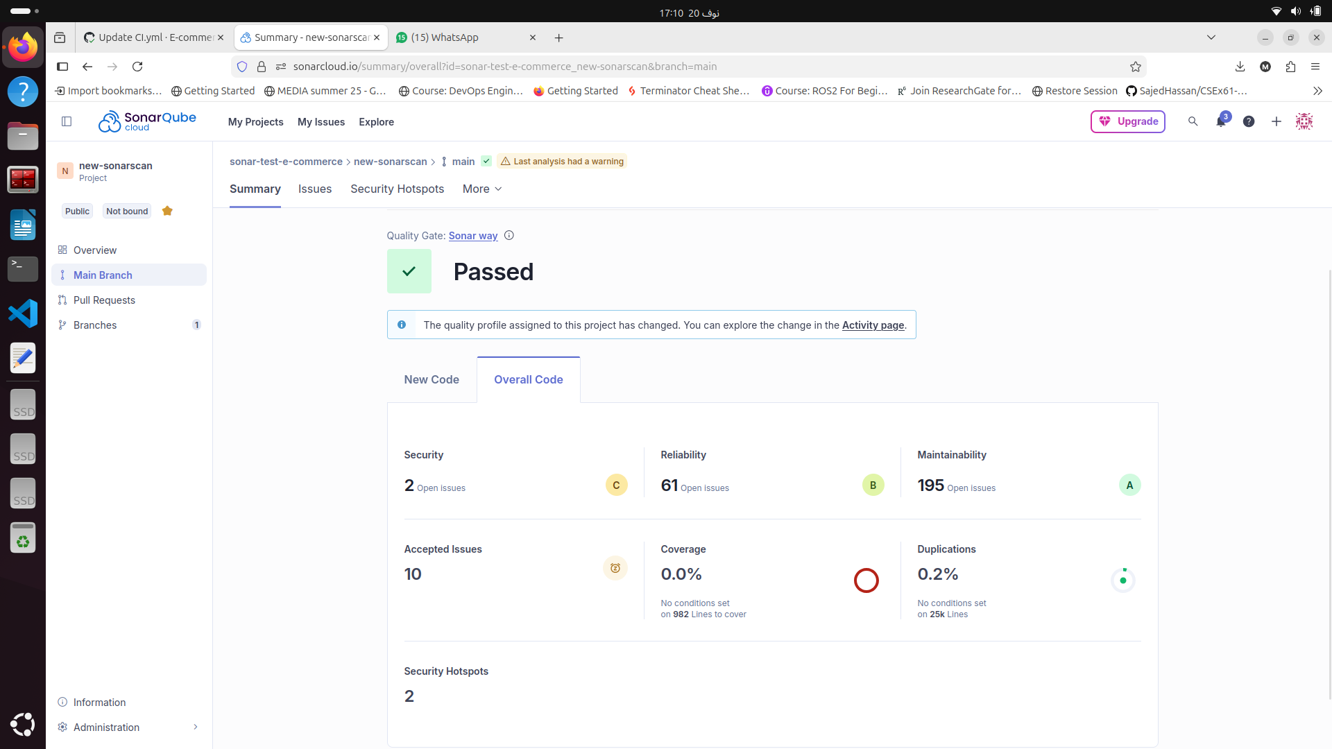
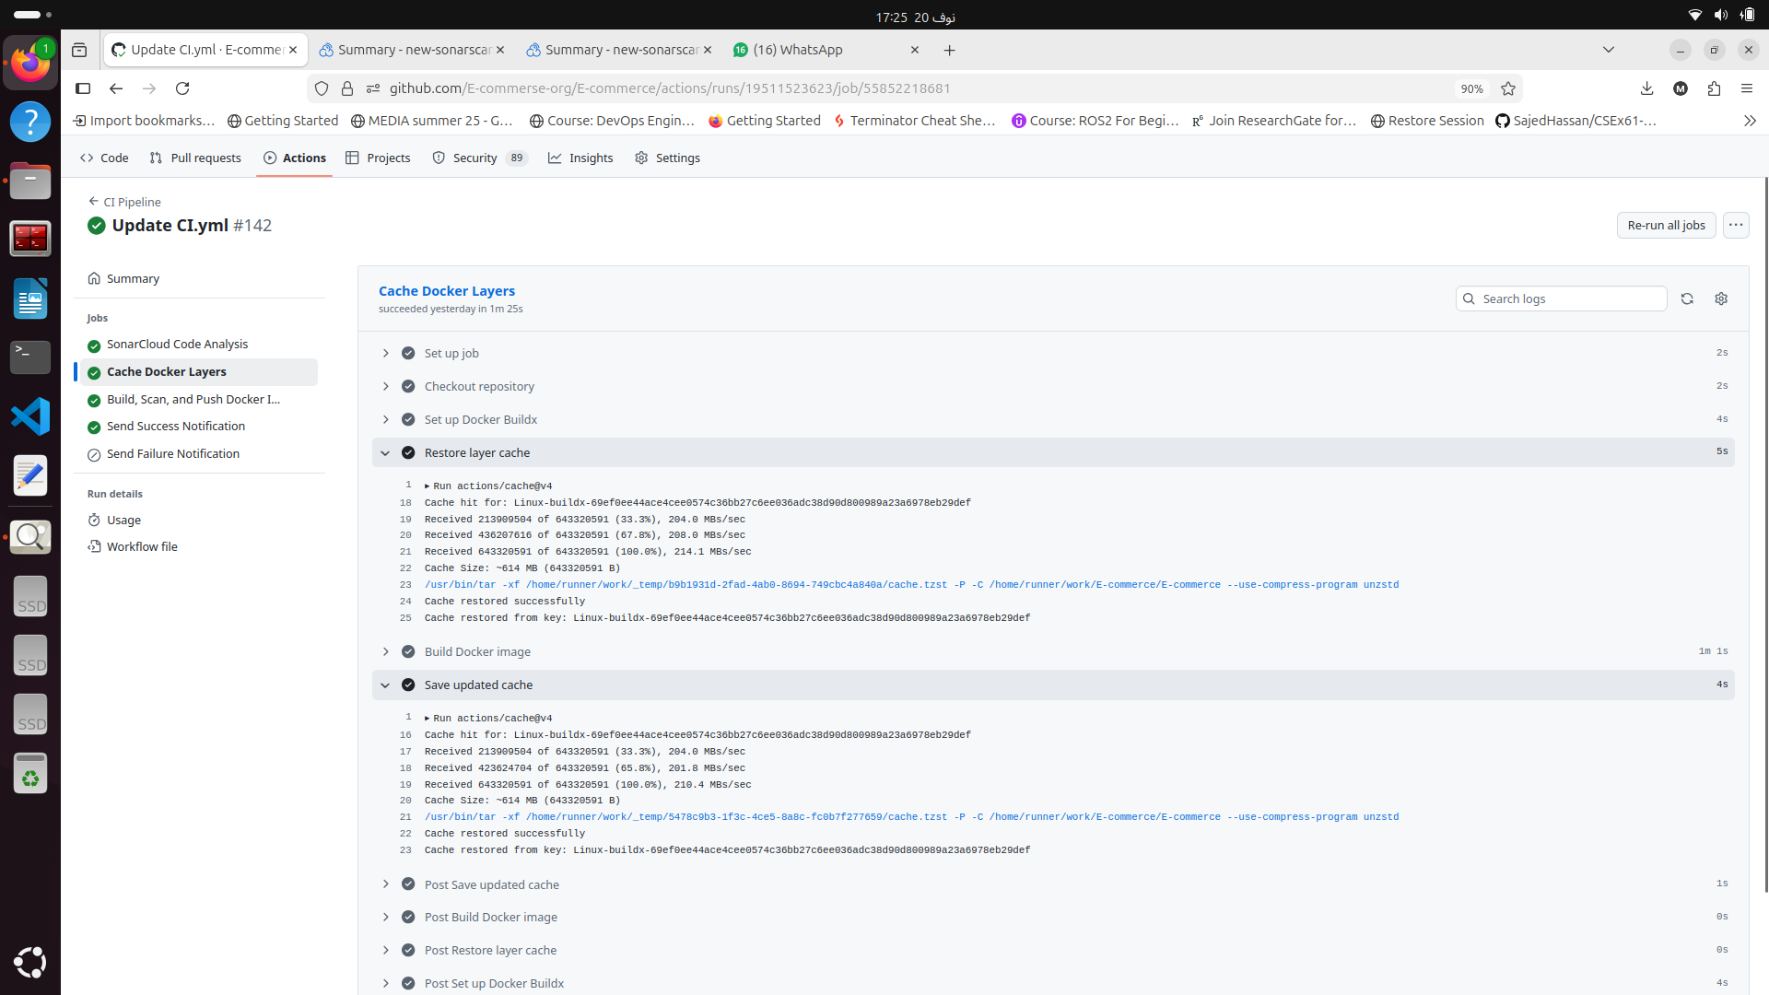
Sonarcloud Analysis
Docker Layer Caching

Slide 11
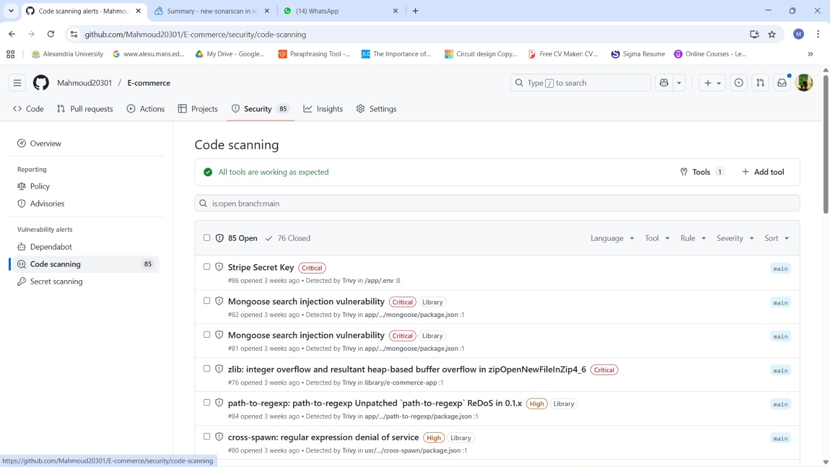
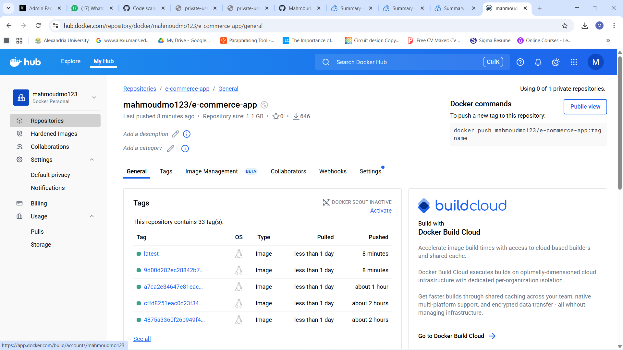
Scan Image with Trivy
Push Image to Dockerhub

Slide 12
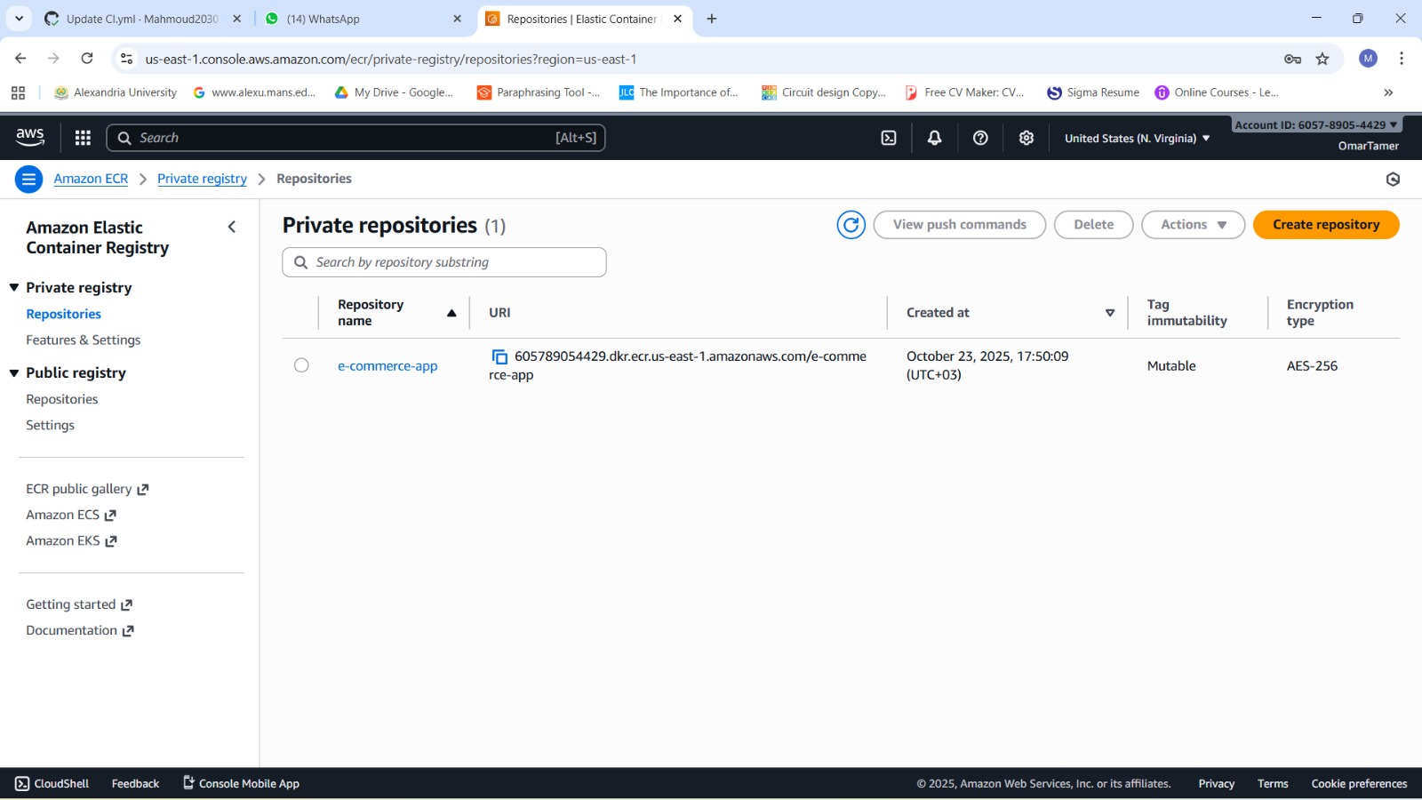
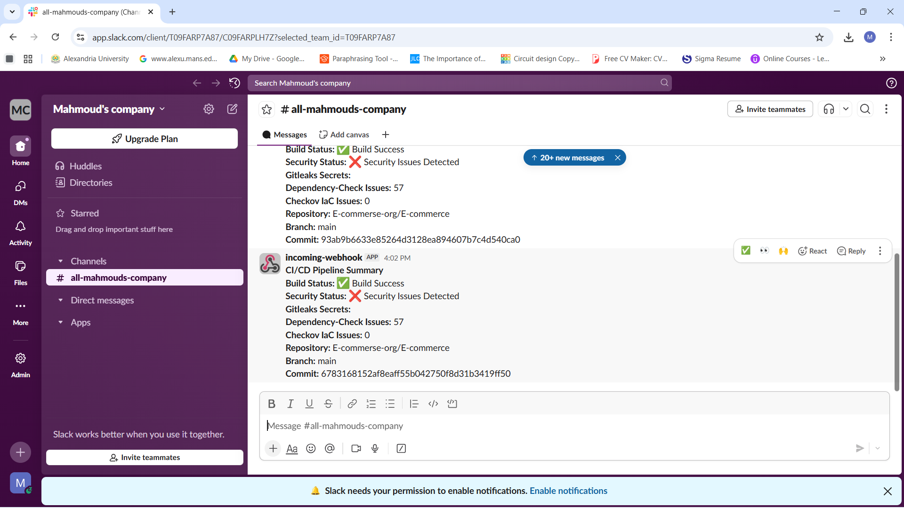
Push Image to Amazon ecr
Slack notification message

Slide 13
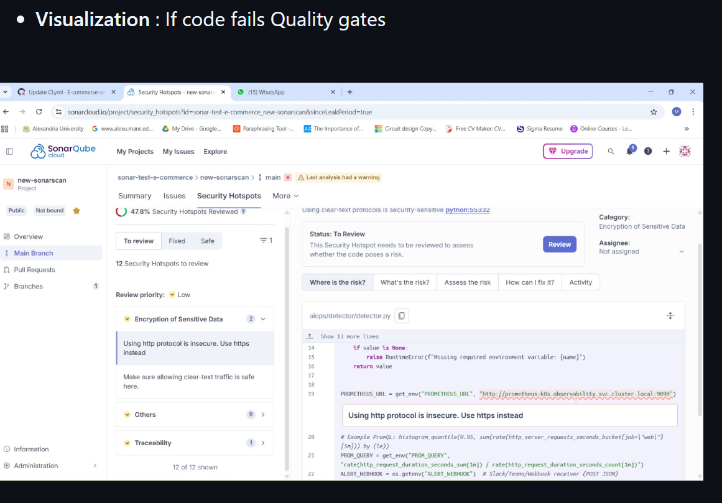
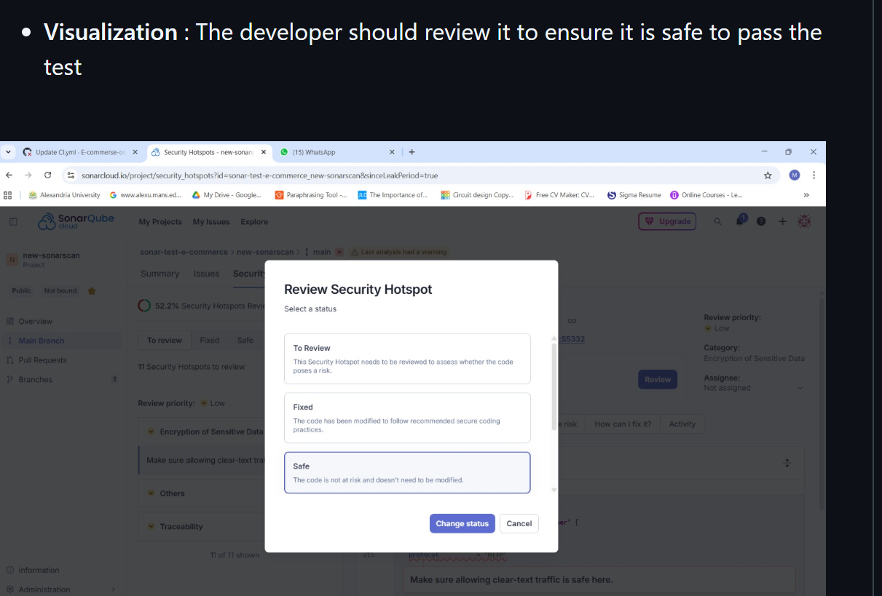

Slide 14


03
Kubernetes Monitoring Layer on EKS

Slide 15
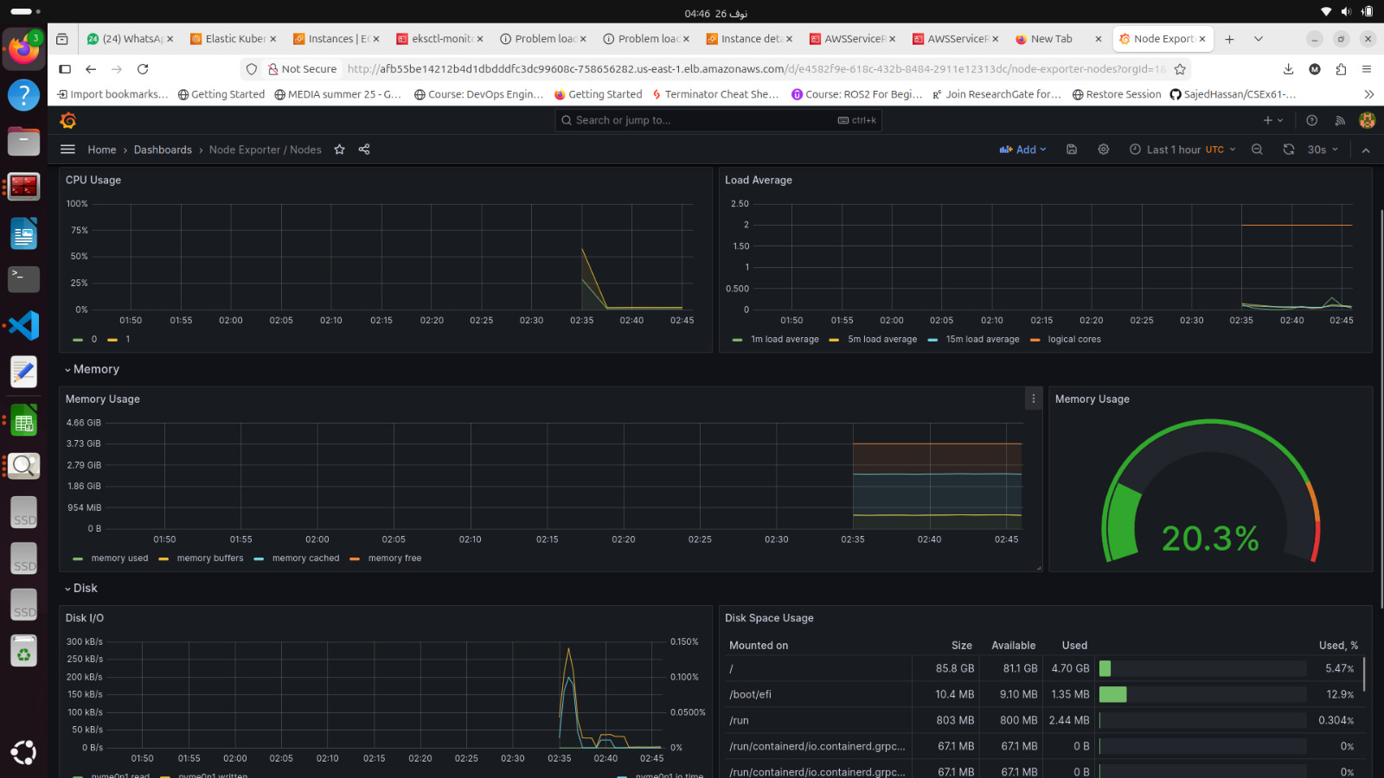
Kubernetes Monitoring Layer on EKS
A robust monitoring stack deployed on Amazon EKS provides comprehensive observability into our application and infrastructure, ensuring peak performance and stability.
Prometheus
High-performance metrics collection and storage, forming the backbone of our monitoring system.
Grafana
Dynamic and customizable dashboards for real-time visualization, offering deep insights into system health.
Exporters
Node Exporters & Kube-state-metrics for comprehensive cluster insights and granular data.
Alertmanager
Manages and dispatches alerts to various notification channels, ensuring critical issues are promptly addressed.
Provisioning is automated with Terraform and Helm, providing a reproducible and scalable monitoring setup. Outputs include a direct Grafana dashboard URL and admin credentials for quick access.

Slide 16
Main Features to Include in the EKS Cluster
2] Networking & Load Balancing
Network Load Balancer (NLB)
Expose cluster services using an NLB instead of the default CLB.
Configure Kubernetes service annotations:
service.beta.kubernetes.io/aws-load-balancer-type: "nlb“
service.beta.kubernetes.io/aws-load-balancer-scheme: internet-facing or internal.
Enable cross-zone load balancing for high availability.
NLB auto-provisions automatically via the AWS Load Balancer Controller.
1] Core EKS Cluster Setup
-Create an EKS control plane in us-east-1
-.Use a managed node group running on EC2.
-Use EKSNodeRole that contains the required policies:
AmazonEKSWorkerNodePolicy
AmazonEC2ContainerRegistryReadOnly
AmazonEKS_CNI_Policy

Slide 17
Main Features to Include in the EKS Cluster
4] Vertical Pod Autoscaling (VPA)
Automatically adjusts CPU/RAM requests & limits of pods.
Components deployed:
VPA Recommender
VPA Updater
VPA Admission Controller
Works with HPA but affects resource sizes, not pod count.
3] Horizontal Pod Autoscaling (HPA)
Automatically increases/decreases number of pods based on CPU/memory or custom metrics.
Requires:
Metrics Server installed
YAML example use autoscaling/v2
Typical fields: minReplicas / maxReplicas
Target : CPU Utilization Percentage or memory

Slide 18
Main Features to Include in the EKS Cluster
6] IAM & SecurityNode IAM Role includes:
AmazonEC2ContainerRegistryReadOnly → pull images
AmazonEKSWorkerNodePolicy → worker node access
AmazonEKS_CNI_Policy → CNI plugin
Control plane IAM role using eks.amazonaws.com trust.
Enabled encryption for cluster secrets using KMS
5] Cluster Autoscaler (Node Autoscaling)
Automatically adds/removes EC2 nodes in the node group.
Integrates directly with EKS managed node groups.
Requires: IAM permissions (autoscaling, EC2)
Node group min_size, max_size, and desired_size
Works together with HPA:HPA scales pods
Cluster Autoscaler adds EC2 nodes if pods cannot fit

Slide 19
Main Features to Include in the EKS Cluster
8) Kubernetes Add-ons
CNI plugin
kube-proxy
CoreDNS
NodeGroup Features
Auto-scaling enabled
Multiple availability zones
Works with VPC and private subnets
Supports spot or on-demand instances depending on configuration
7] Additional Features You Mentioned Before
IAM OIDC Provider
Connects the EKS cluster to AWS IAM.
Required for: AWS Load Balancer Controller
Cluster Autoscaler
External DNSEBS CSI Driver (persistent storage)

Slide 20
04
AIOps: Real-time Anomaly Detection

Slide 21
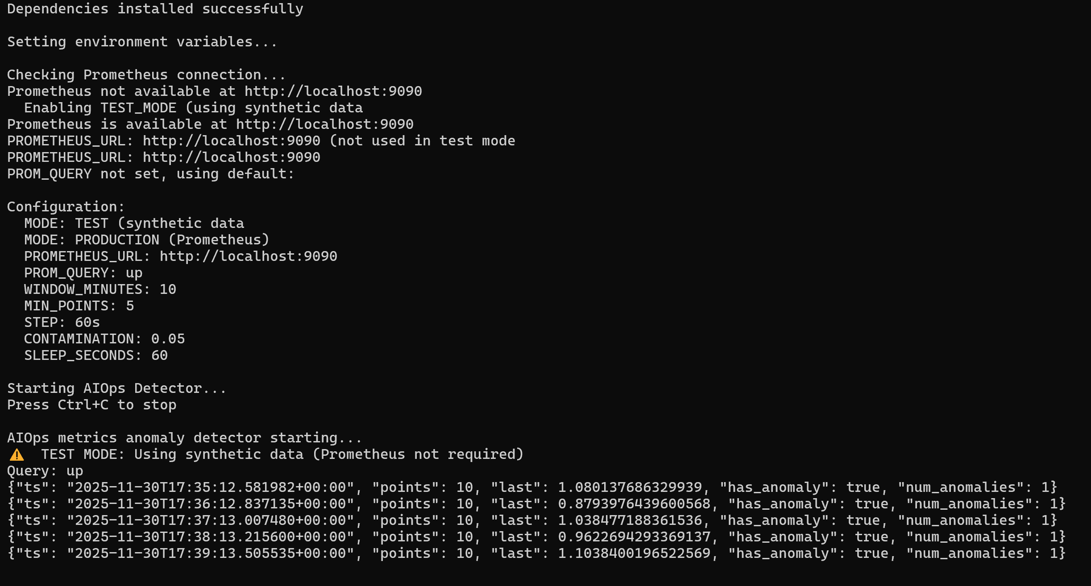
AIOps: Real-time Anomaly Detection
1] Metric Ingestion
4] Multi-channel Notifications
Fetches real-time metrics directly from Prometheus, establishing a continuous data stream for analysis.
Sends alerts to Slack, Teams, and custom webhooks for broad coverage and immediate response.
2] Isolation Forest
Utilizes Python's IsolationForest algorithm for efficient anomaly identification with high precision.
3] Intelligent Alerting
Detects spikes, drops, and subtle anomalies, generating actionable alerts to prevent outages.

Slide 22
05
Terraform Infrastructure: Multi-Cell EKS

Slide 23
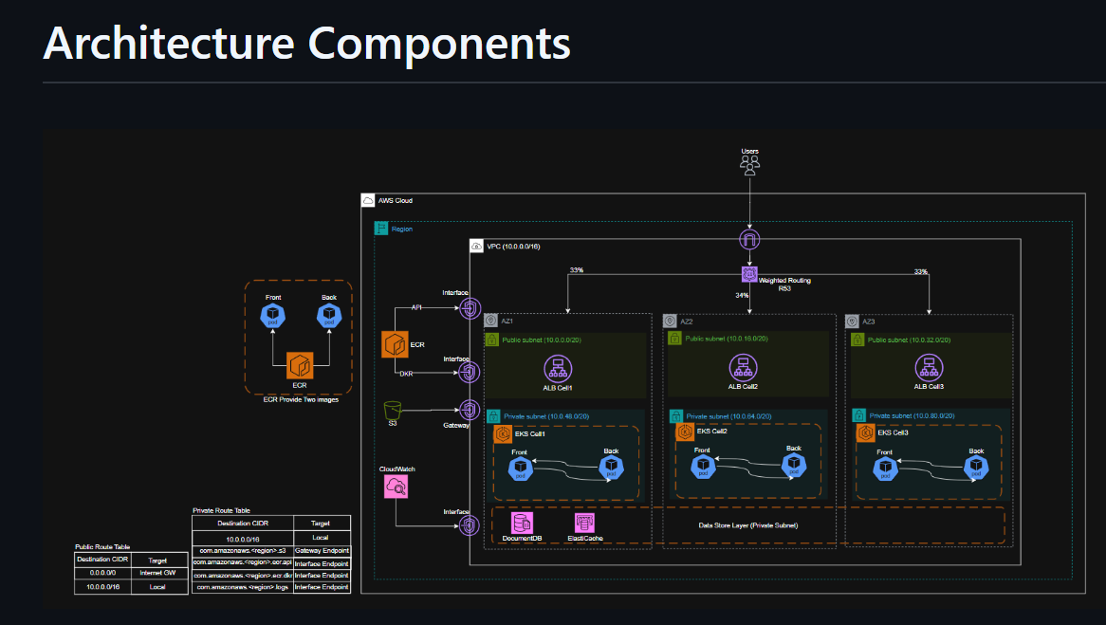
Main Features to Include in the EKS Cluster

Slide 24
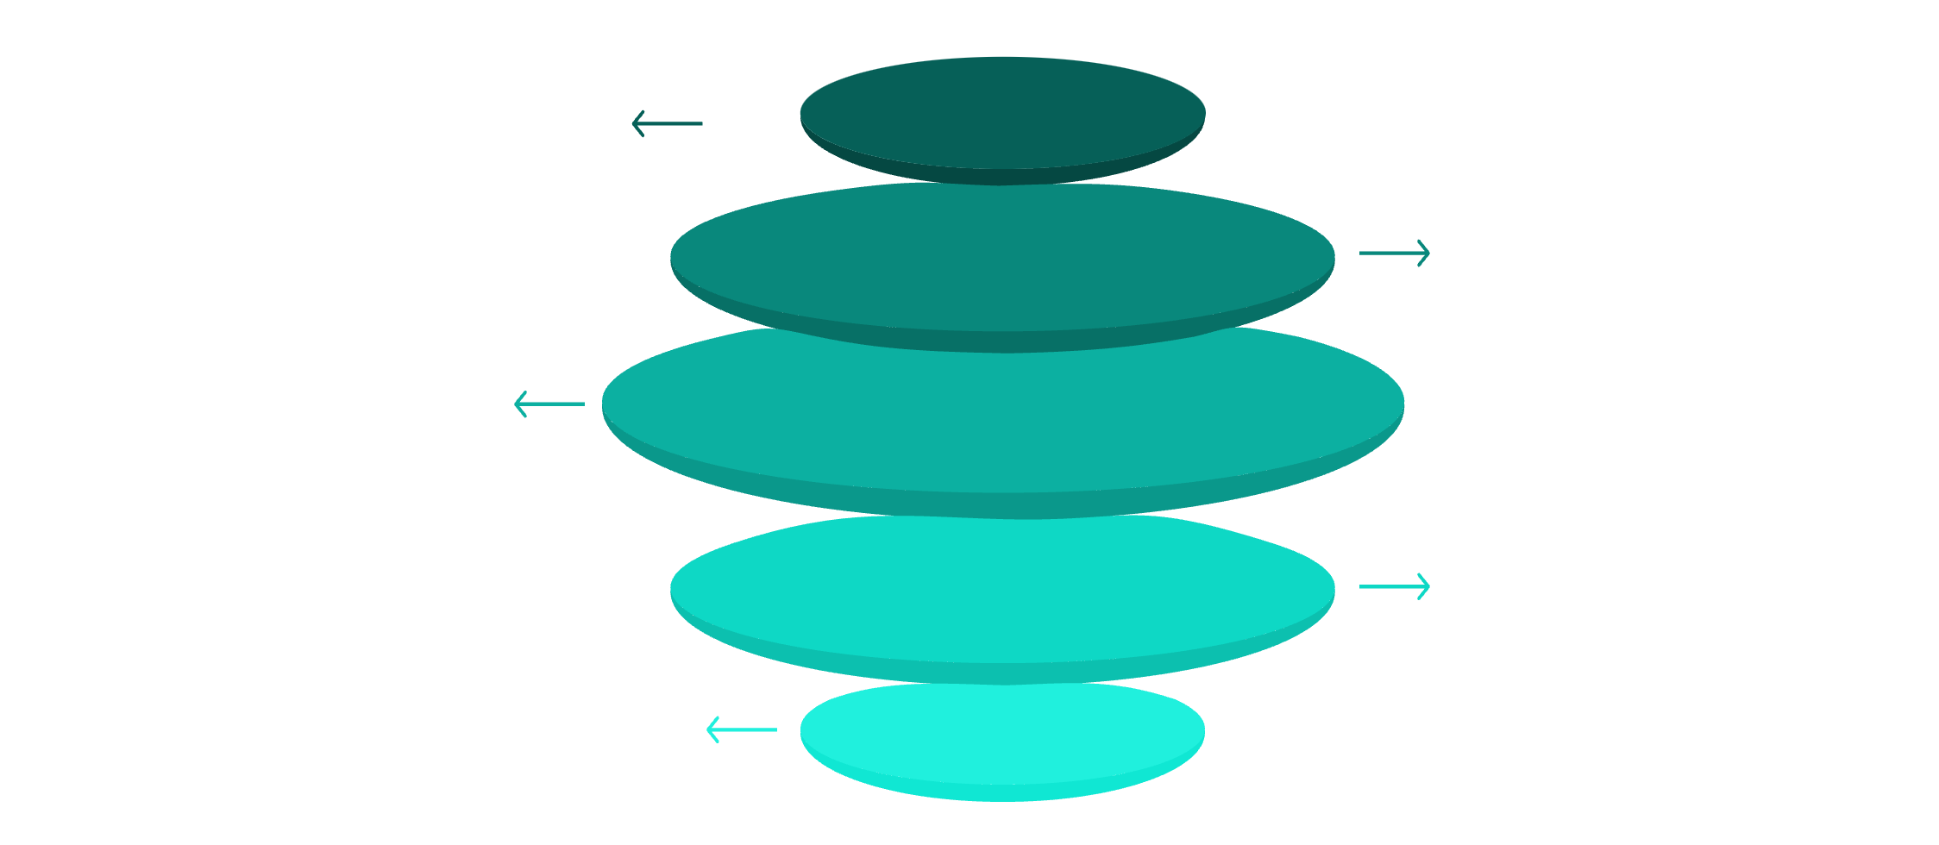
Terraform Infrastructure: Multi-Cell EKS
Our infrastructure is meticulously managed by Terraform, deploying a highly available and fault-isolated multi-cell EKS architecture for maximum resilience.
Cell1
Independent EKS cluster with core controllers
Cell2
Isolated cluster for service boundary
Cell3
Independent cluster for resilience
Shared VPC
ALB/NLB, LB Controller, Autoscaler
Shared Services
IAM, ECR, S3, CloudWatch
Cell1 EKS
Independent cluster with core controllers, providing a baseline for service stability.
Cell2 EKS
Isolated cluster for fault domain separation, enhancing overall system resilience.
Cell3 EKS
Independent cluster for workload isolation, preventing cascading failures and ensuring service integrity.
Shared VPC Services
ALB/NLB, LB Controller, Autoscaler, IAM, ECR, S3, CloudWatch for centralized management and optimized resource utilization.

Slide 25
06
Deployment Process

Slide 26





Streamlined Deployment Process
Our deployment workflow ensures consistent and automated provisioning of our cloud infrastructure and services, enabling rapid and reliable releases.
Terraform Initialization
terraform init and terraform plan prepare the environment and preview changes, ensuring transparency and control.
Apply Dev Configuration
terraform apply provisions the development environment with predefined configurations, ready for testing.
Kubectl Configuration
Dynamically configures kubectl for seamless interaction with each EKS cluster, simplifying management.
Deploy NLB Service
Deploys the Network Load Balancer (NLB) service, exposing applications securely to external traffic.

Slide 27







Project Summary: Key Achievements
This project delivers a state-of-the-art solution, combining advanced DevOps practices with intelligent operational capabilities, setting a new standard for cloud-native applications.
Optimized Builds
Automated CI/CD
Cloud-Native K8s
Multi-stage Docker builds for lean and efficient containers, reducing attack surface and deployment times.
Secure pipelines ensuring continuous delivery and quality, accelerating time-to-market.
Robust deployment on Amazon EKS for scalability, resilience, and efficient resource management.
Terraform Infra
Full Observability
Intelligent AIOps
Infrastructure as Code for reproducible environments, ensuring consistency and version control.
Prometheus, Grafana, Alertmanager for deep insights, proactive monitoring, and rapid incident response.
Metrics-based anomaly detection for proactive issue resolution, minimizing human intervention.
Fault-Isolated Design
Multi-cell architecture for high resilience and availability, protecting against single points of failure.

Slide 28
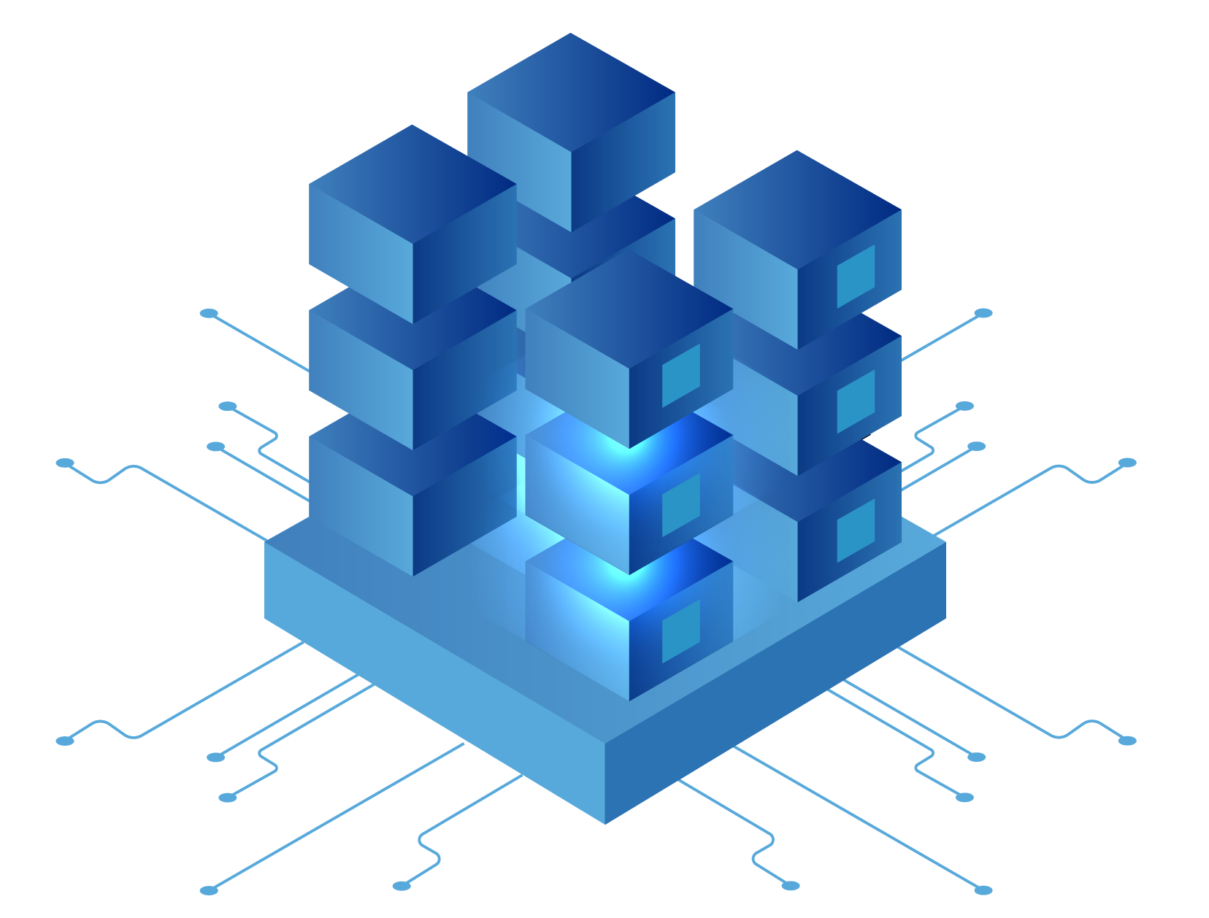
THANKS!

